Slide 1
Travelling of the future
🚀

Slide 2

problem
Travelling is nice, but planning is not

Slide 3
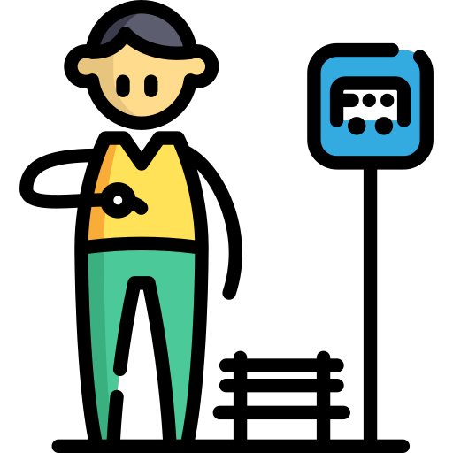


problem
I’ve 6 hours to catch a ride, in paris, what can I do?
Where to eat?
Where to go?
Where do I book a ticket for visiting the louvre museum?

Slide 4
We present you...

Slide 5


Slide 6

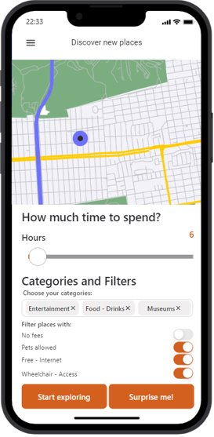
Automatically create a route with activities to spend your time

Slide 7
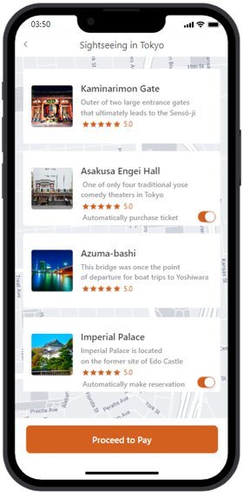
In-app tickets purchase for a smooth experience

Slide 8
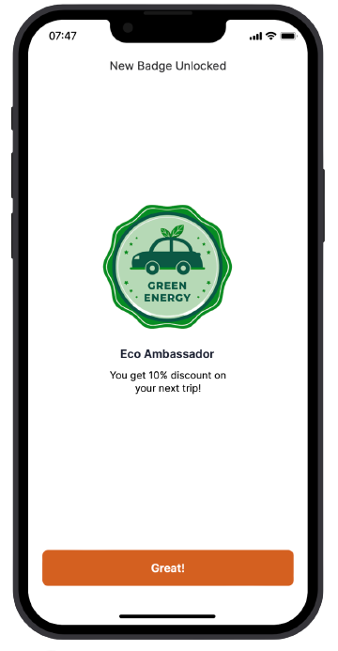
Eco friendly! earn discounts and badges! We support green transportation

Slide 9

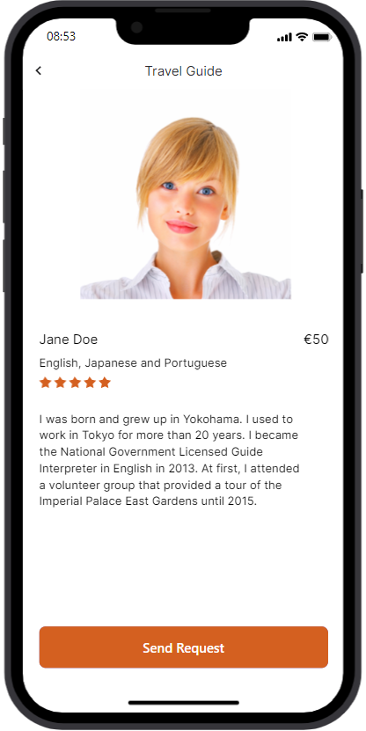
Request a local travel guide tailored for your route

Slide 10

Improve your next trips with AI based on your history profile …and more!

Slide 11


business model
We take a 5% fee for each route in-app expense
Paid “premium” features
Affiliate marketing
% Profit margin agreements with business partners

Slide 12






customer example
6 hours to spend
In Paris
Walk and public transports
Spend between 100€ - 150€
Entertainment
1 person

Slide 13
Name | Time | Cost
Initial location - Arc de Triomphe | - | -
Transport - Subway | 25 min | 2€
Eiffel Tower | 1,5 h | 18€
Transport - Bus | 30 min | 3€
Escape Game | 1 h | 40€
Transport - Bus | 20 min | 2€
Bike Tour | 2 h | 40€
Total | 5,75 h | 105€
Total with fee (5%) | 5.75 H | 110.25€

Slide 14
105€ x 0.05 = 5.25€
Client Fee (5%)
105€ x 0.01 = 1.05€
Margin Profit with partners (~1%)
6.3€
Total Profit

Slide 15
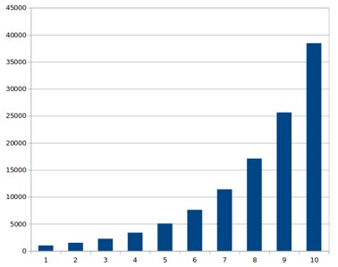
Yearly Total Trips Sold - traction
50%
AVG Yearly Grow
Yearly total Trips Sold – 10 Years forecast

Slide 16
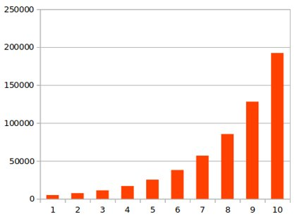
Yearly Gross Sales - traction
50%
AVG Yearly Grow
Yearly Gross sales - 10 years forecast (in euros)

Slide 17
DeMO

Slide 18
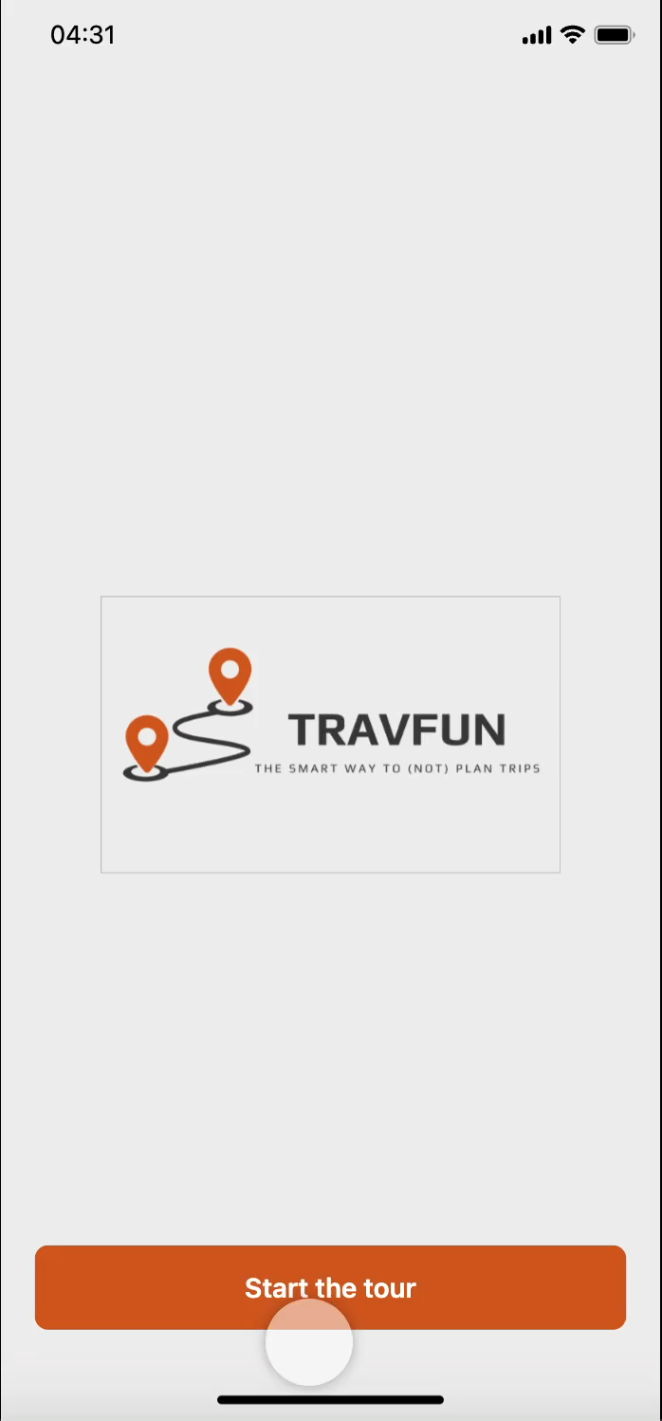
Notes:
40s

Slide 19
Thanks!

